Slide 1
SHIFT REGISTERS

Slide 2
S-1 | SLO-1 | Registers and Types of Registers- Serial In - Serial Out, Serial In - Parallel out
 | SLO-2 | Parallel In - Serial Out, Parallel In - Parallel Out

Slide 3
REGISTERS
Shift registers are types of sequential logic circuits closely related to digital counters used primarily for the storage of data
Slides 3

Slide 4
DATA STORAGE
transfer 0 from input to output
transfer 1 from input to output
0
D
Q
0
1
D
Q
1
CLK
CLK
CLK
CLK
Q
Q
Q → 0 at the clock NGT
Q → 1 at the clock NGT
Slides 4
Notes:
4

Slide 5
DATA STORAGE AND SHIFT
Storage capacity (number of bits) of a register is determined by the number of flip-flops
- One flip flop represents one bit of data storage
- “n” number of flip-flops can store an n-bit data
The FFs interconnection should facilitate
- transfer of binary data into and out of the register, and
shifting data within the register one or more bit positions left or right, effected upon the application of clock pulses
If no clock pulses are applied, there will be no data shift in the register
Slides 5
Notes:
5

Slide 6
DATA MANIPULATION
Data can written in and read out from a register either serially (one bit at a time) or in parallel (all bits simultaneously)
Serial In Parallel Out (SIPO)
Serial In Serial Out (SISO)
D_{in}
D_{in}
Q
Data In
Data In
Data Out
Q
Q
Q
Q
Data Out
Parallel In Serial Out (PISO)
Parallel In Parallel Out (PIPO)
Data In
Data In
D_{in}
D_{in}
D_{in}
D_{in}
Data Out
D_{in}
D_{in}
D_{in}
D_{in}
Q
Q
Q
Q
Q
Data Out
Slides 6
Notes:
6

Slide 7
4 TYPES OF DATA MOVEMENT
Type 1 - Serial In Parallel Out (SIPO)
Data bits are entered serially into the shift register.
Each bit appears on its respective output line, and all bits are available simultaneously.
Type 2 - Serial In Serial Out (SISO)
The serial in serial out shift register accepts data serially, i.e. one bit at a time on a single line.
It produces stored information on its output also in serial form.
Slides 7
Notes:
7

Slide 8
4 TYPES OF DATA MOVEMENT
Type 3 - Parallel In Serial Out (PISO)
Data bits are entered simultaneously into their respective stages in parallel fashion.
The output is serial i.e. shifting one bit at a time on a single line.
Type 4 - Parallel In Parallel Out (PIPO)
Data bits are entered simultaneously into their respective stages in parallel. All bits are also available at the respective output stage in parallel.
Slides 8
Notes:
8

Slide 9
SIPO Register Basic Operation
Accepts data serially on bit by bit basis
Once data is stored, each data bit appears simultaneously on its respective output line
Application of SIPO:
- A computer or microprocessor based system commonly processes data in parallel format.
- Hence, serial incoming data is converted into parallel format through a SIPO register
Slides 9
Notes:
9

Slide 10
Example 1: 4-bit Shift SIPO Register
D₀
Q₀
D₁
FF1
Q₁
D₂
Q₂
D₃
FF3
Data Input (Din)
FF0
FF2
Q₃
SERIAL
CLK
Q₀
Q₁
Q₂
Q₃
PARALLEL OUTPUTS
T1
T2
T3
T4
CLK
CLK | Din | Q₀ | Q₁ | Q₂ | Q₃
Initial
T1
T2
T3
T4
Din
x
0
0
0
0
Q₀
1
1
0
0
0
Q₁
0
0
1
0
0
1
1
0
1
0
Q₂
0
0
1
0
1
Q₃
Show the contents of the register for the data input and clock given. Initial register value is 0.
Slides 10
Notes:
10

Slide 11
SISO Register Basic Operation
Data is shifted into the register on bit by bit basis.
After the data is stored completely, it can be shifted out serially upon further application of the clock pulses
Application of the SISO Register
- The SISO shift register can be used to provide a time delay from input to output.
- This delay is a function of the number of FFs in the register and clock period.
Slides 11
Notes:
11

Slide 12
4-bit SISO shift register using D-FFs
Data Input
D₀
FF0
Q₀
D₁
FF1
Q₁
D₂
FF2
Q₂
D₃
FF3
Q₃
Data Output
SERIAL
SERIAL
CLK
Data Advance (clock) connected to PGT → Data is shifted when clock signal changes from 0 to 1
Slides 12
Notes:
12

Slide 13
Example 2: 3-bit shift SISO register
1
1
0
0
0
Data Input (Din)
D₀
FF0
Q₀
D₁
FF1
Q₁
D₀
FF2
Q₂
Data output
SERIAL
SERIAL
CLK
CLK | Din | Q₀ | Q₁ | Q₂
Initial | x
T1
T2
T3
T4
T5
T6
T1
T2
T3
T4
T5
T6
0
0
0
CLK
1
1
0
0
Din
1
0
0
0
1
0
Q₀
0
1
1
0
1
0
0
1
0
Q₁
1
0
0
0
1
Data Out (Q₂)
0
0
0
0
Show the state of the output Q of the 3-bit SISO register for the data input and clock given. Initial register value is 0.
Slides 13
Notes:
13

Slide 14
Parallel In Parallel Out Shift Register
All the data bits are entered and available on the output lines simultaneously.
Application: For synchronization of signals and data transfer
D₀
D₁
D₂
D₃
D₁ Q₁
D₂ Q₂
D₃ Q₃
D₀ Q₀
CLK
CLK
CLK
CLK
FF0
Q₀
FF1
Q₁
FF2
Q₂
FF3
Q₃
CLK
Qo Q₁ Q₂ Q₃
4-bit PIPO shift register using D flip-flops
Slides 14
Notes:
14

Slide 15
For the 4-bit PIPO register below, the initial states are given Q₀Q₁Q₂Q₃= 1000. what are the outputs of registers immediately after 3rd clock pulse?
Example 4
0 0 1 1
0 0 1 1
Input data
1 0 0 0
Outputs of registers will always be 0011 after first and subsequent clock pulses. Why?
Input data at D is fixed
Slides 15
Notes:
15

Slide 16
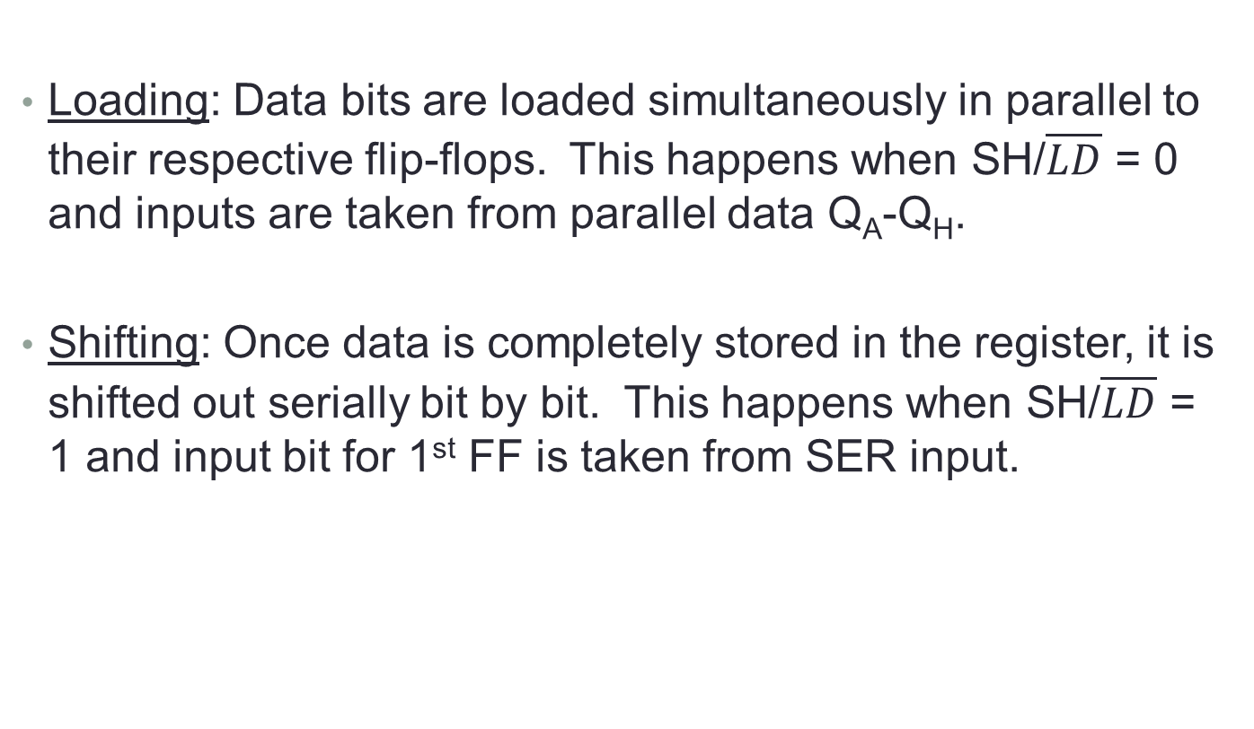
Parallel In Serial Out Shift Register
Loading: Data bits are loaded simultaneously in parallel to their respective flip-flops. This happens when SH/$\overline{LD}$ = 0 and inputs are taken from parallel data Q_{A}-Q_{H}.
Shifting: Once data is completely stored in the register, it is shifted out serially bit by bit. This happens when SH/$\overline{LD}$ = 1 and input bit for 1st FF is taken from SER input.
Slides 16
Notes:
16

Slide 17
Parallel In - Serial Out Shift Registers
The circuit uses D flip-flops and NAND gates for entering data (ie writing) to the register.
D0, D1, D2 and D3 are the parallel inputs, where D0 is the most significant bit and D3 is the least significant bit.
To write data in, the mode control line is taken to LOW and the data is clocked in.
The data can be shifted when the mode control line is HIGH as SHIFT is active high.

Slide 18
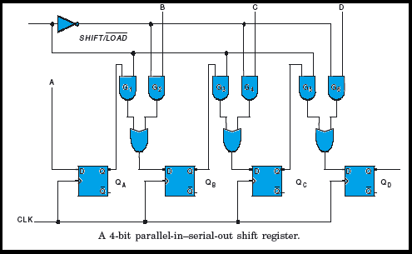
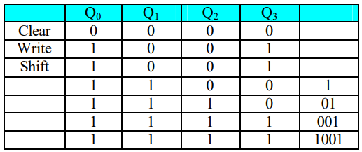

Slide 19
S-2 | SLO-1 | Universal Shift Register
 | SLO-2 | Applications of Shift Registers

Slide 20
Universal Shift Register
The universal shift register can be defined as “The register which can be used to shift the data in both the directions like left, right and can load parallel data as well”.
This register can perform three types of operations, stated below.
Parallel loading
Shifting left
Shifting right.

Slide 21
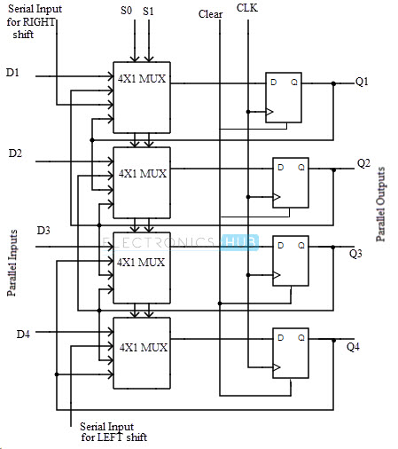
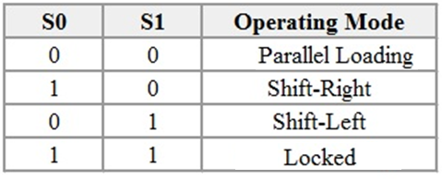

Slide 22
Application of Shift Register
Delay line
Serial to parallel converter
Parallel to serial converter
Shift register counter
Sequence generator

